Slide 1

Utilidades adicionales para Falco

Slide 2
Falco: Utilidades adicionales, webs y artículos de referencia, demo uso con Docker

Slide 3
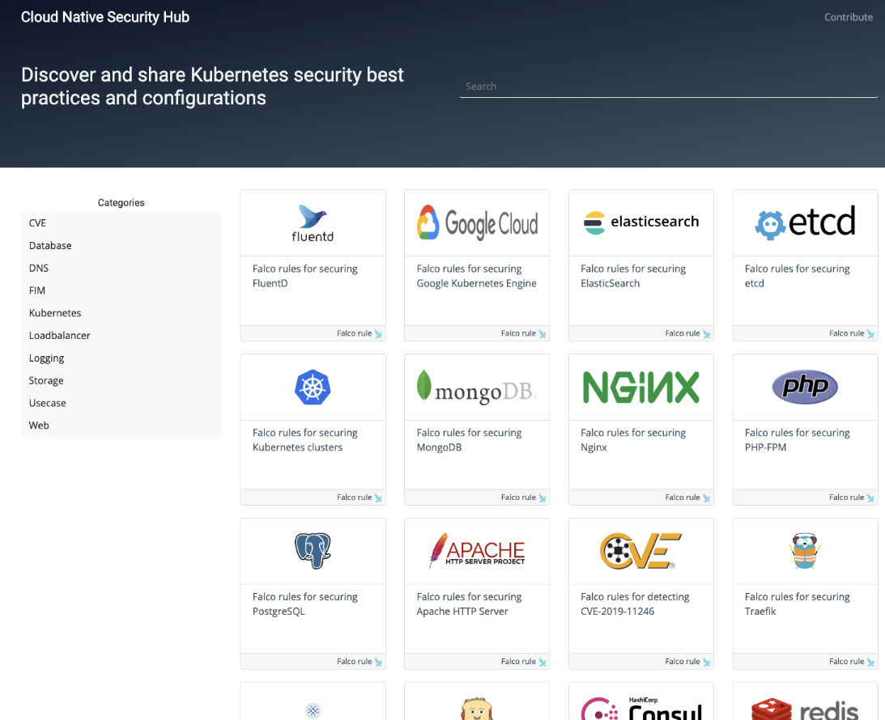
Cloud Native Security Hub
https://securityhub.dev

Slide 4
Utilidades más interesantes
Kubernetes Response Engine Send events to serverless functions to execute playbooks https://github.com/falcosecurity/kubernetes-response-engine
Falco Sidekick Send events to other targets as Slack, PagerDuty, etc. https://github.com/falcosecurity/falcosidekick
Event generator Binary that executes commands that Falco rules should detect https://falco.org/docs/event-sources/sample-events/

Slide 5
Ejemplo: Instalar Falco con Docker
# Instalar driver de Kernel
docker pull falcosecurity/falco-driver-loader:latest
docker run --rm -i -t \
--privileged \
-v /root/.falco:/root/.falco \
-v /proc:/host/proc:ro \
-v /boot:/host/boot:ro \
-v /lib/modules:/host/lib/modules:ro \
-v /usr:/host/usr:ro \
-v /etc:/host/etc:ro \
falcosecurity/falco-driver-loader:latest
# Ejecutar Falco con privilegios
docker pull falcosecurity/falco:latest
docker run --rm -i -t \
--privileged \
-v /var/run/docker.sock:/host/var/run/docker.sock \
-v /dev:/host/dev \
-v /proc:/host/proc:ro \
-v /boot:/host/boot:ro \
-v /lib/modules:/host/lib/modules:ro \
-v /usr:/host/usr:ro \
-v /etc:/host/etc:ro \
falcosecurity/falco:latest

Slide 6
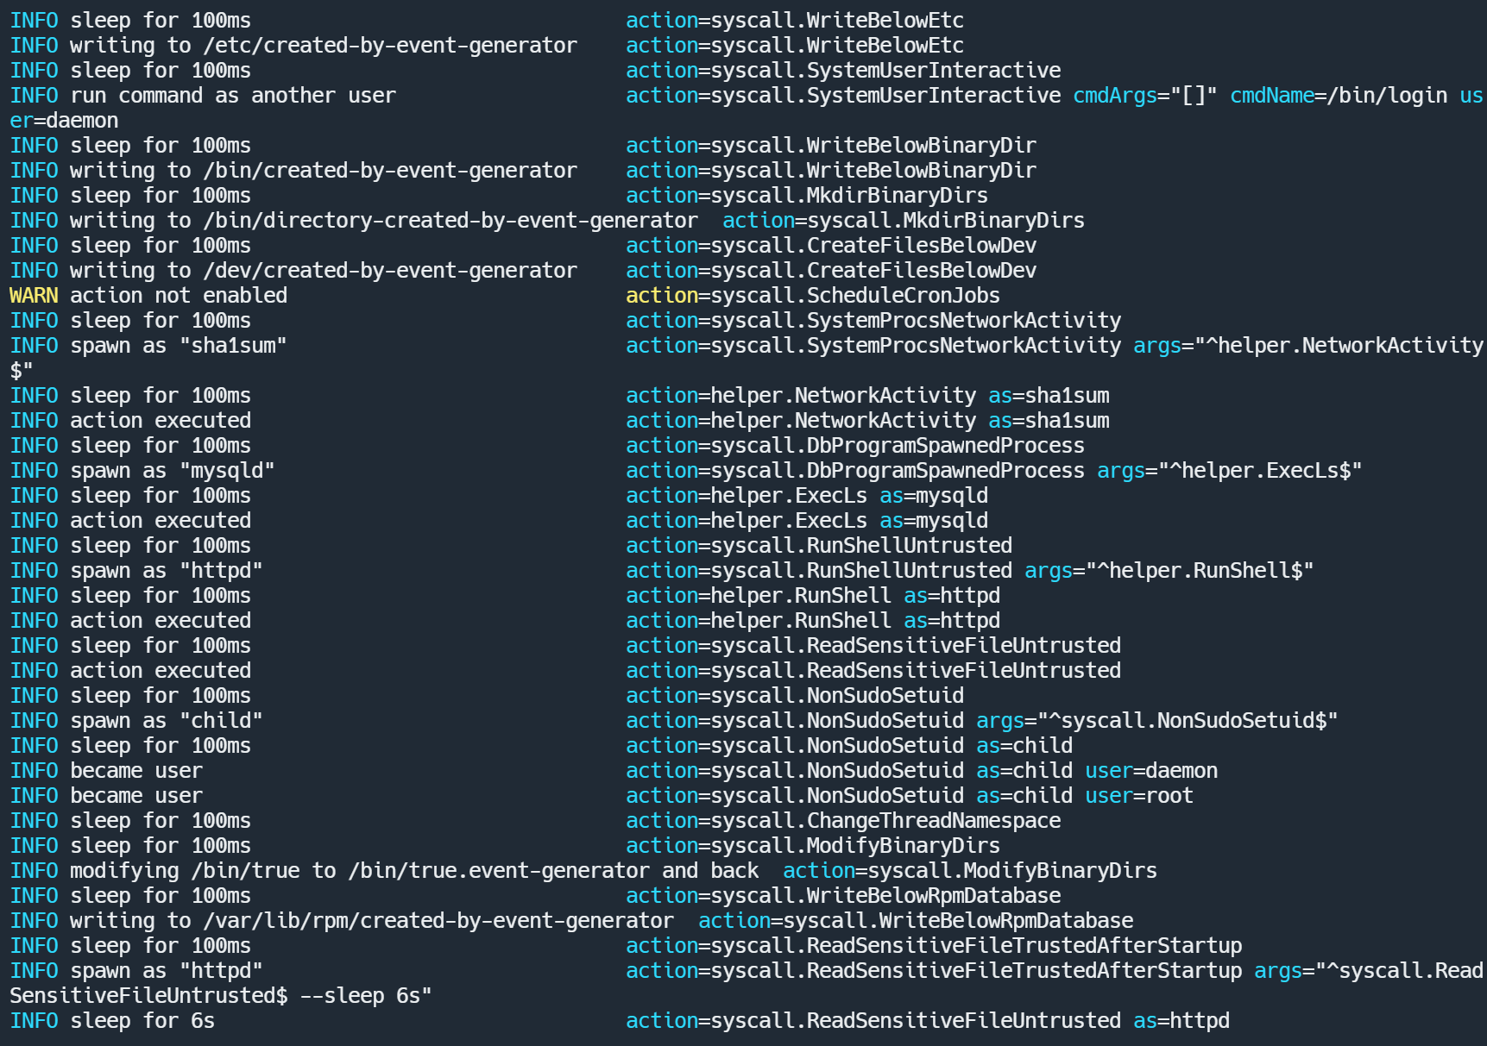
Ejemplo: Ejecutar event generator
docker run -it --rm falcosecurity/event-generator run syscall --loop

Slide 7
Utilidades nicho
Falco Prometheus Exporter Prometheus metrics for Falco security events https://github.com/falcosecurity/falco-exporter
Falco PSP Convert Convert PSP to Falco rules to test them before enforcing https://falco.org/docs/psp-support/

Slide 8
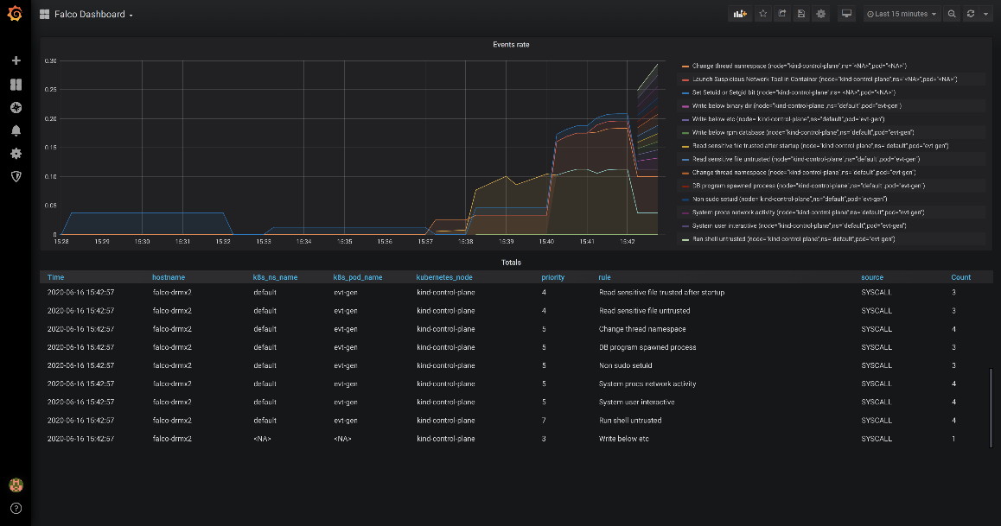
Blog de Falco
Falco on Kind with Prometheus and Grafana https://falco.org/blog/falco-kind-prometheus-grafana/
Detect CVE-2020-8557 using Falco https://falco.org/blog/detect-cve-2020-8557/

Slide 9
Artículos externos sobre Falco
Shopify, enforcing runtime security with Falco Upcoming talk at Kubecon 2020 https://events.linuxfoundation.org/kubecon-cloudnativecon-europe/
Runtime Security in Rancher with Falco https://rancher.com/blog/2020/runtime-security-with-falco/

Slide 10
Artículos de Sysdig sobre Falco
MITRE ATT&CK framework for container runtime security with Falco https://sysdig.com/blog/mitre-attck-framework-for-container-runtime-security-with-sysdig-falco/
Protection From Malicious Python Libraries Jeilyfish and Python3-dateutil https://sysdig.com/blog/malicious-python-libraries-jeilyfish-dateutil/
SELinux, Seccomp, Falco, and you: A technical discussion https://sysdig.com/blog/selinux-seccomp-falco-technical-discussion/

